Slide 1
Cyclists impact in colorado
Katrina Brown, Triston Cavaness, Lesley Conn

Slide 2
Focus of Study
Using data gathered from the state of Colorado bicycle and pedestrian counts from 20 counties across the state taken from 2009 to 2015, the team used Python, Jupyter Notebook and shared coding via GitHub to analyze bicycle traffic to determine usage rates for bicycle paths and crossings around the state.

Slide 3
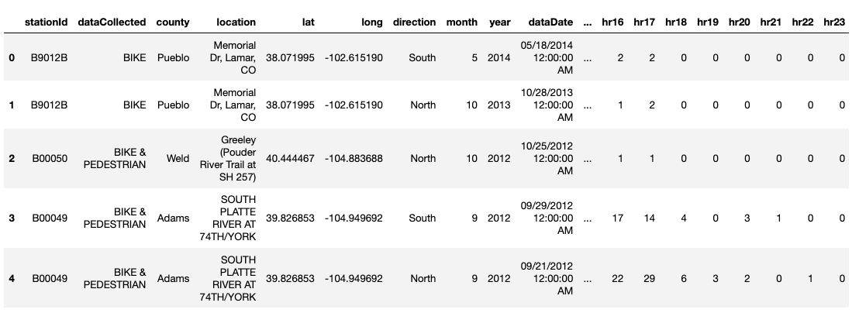
Problem/question
FIRST STEP: Data cleanup and examining data across counties, years

Slide 4
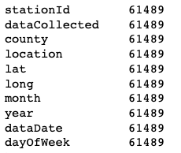
NEXT STEP: REMOVING NULL VALUES FROM DATA, REMOVING COLUMNS, GROUPING HOURS INTO DAY

Slide 5
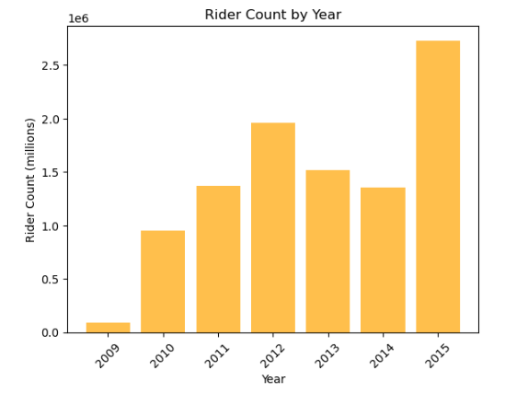
TRACKING STATEWIDE DATA
Statewide ridership counts shows disparate annual totals, suggesting that in the initial year, 2009, state funding was limited. Only two counties, Denver and Jefferson, were included. In the final year, 2015, 20 counties were included.

Slide 6
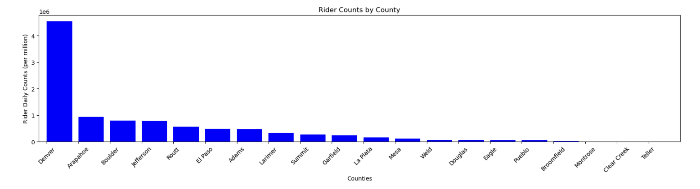
TRACKING STATEWIDE DATA

Slide 7
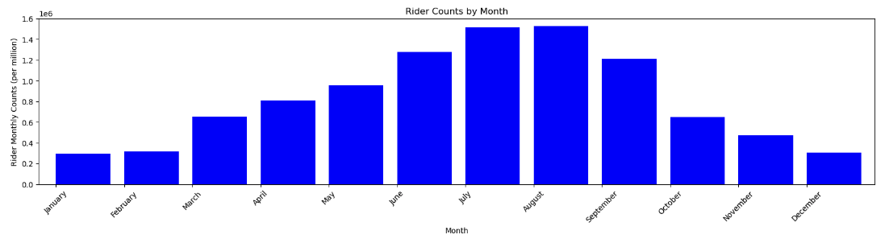
STATEWIDE RIDERSHIP BY MONTH

Slide 8
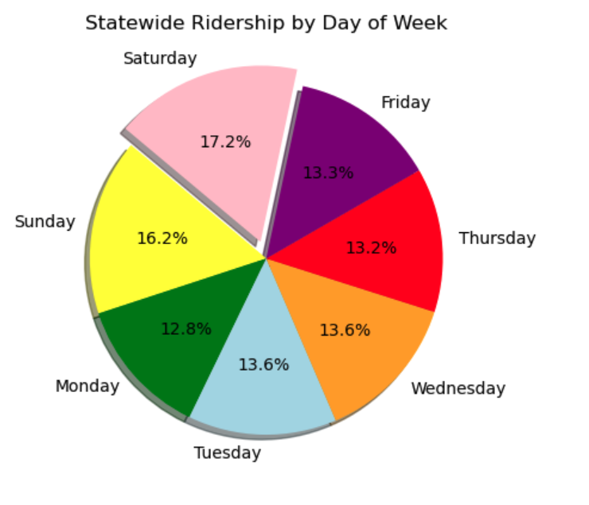
STATEWIDE DATA EVALUATING DAILY COUNTS
Statewide, Saturday and Sunday proved the most popular day of the week across the state. More granular analysis on county levels showed other days were more popular, suggesting differences in rider behavior or need.

Slide 9
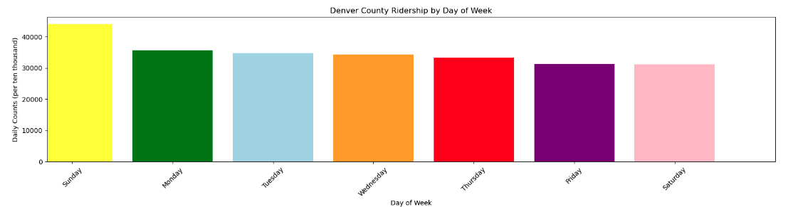
BREAKING DATA DOWN BY COUNTY LEVEL
In Denver County, Sunday was the most heavily trafficked day for bicycle ridership, the same as state levels. However, though Denver is the most populous county, the state totals by day of week for Sunday were only half the Denver ridership counts.

Slide 10
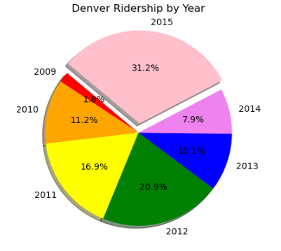
BREAKING DATA DOWN BY COUNTY LEVEL
County-level data reflects a similar growth in ridership data as the state level: As years progressed more locations were added at a county level, gradually increasing reporting in ensuing years.

Slide 11
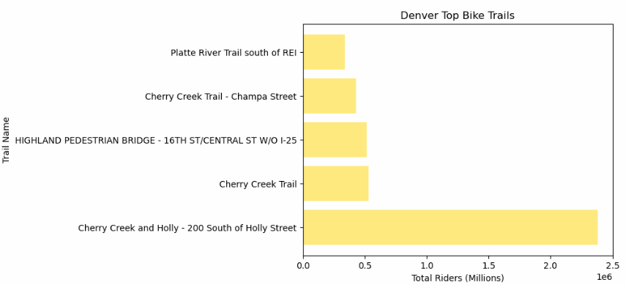
BREAKING DATA DOWN BY COUNTY LEVEL
The database also allowed for comparison of trails and paths within each county. In Denver County, one of the most affluent areas showed the highest ridership.

Slide 12
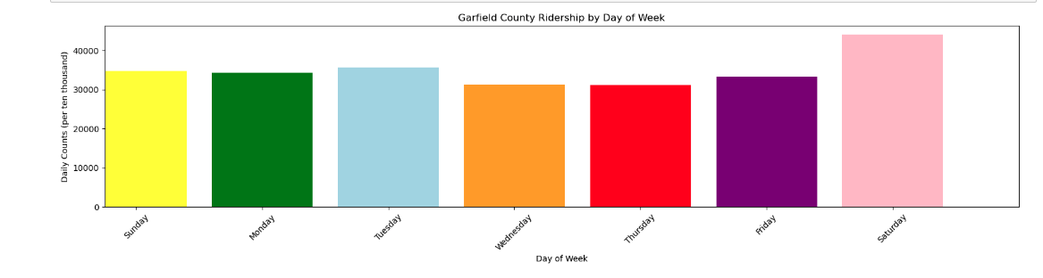
COMPARING LARGE METRO VS. TOURIST COUNTY
Sunday remained the most popular day of the week in Garfield County, which includes Glenwood Springs, but the second-most popular day shifted from Saturday to Tuesday.

Slide 13
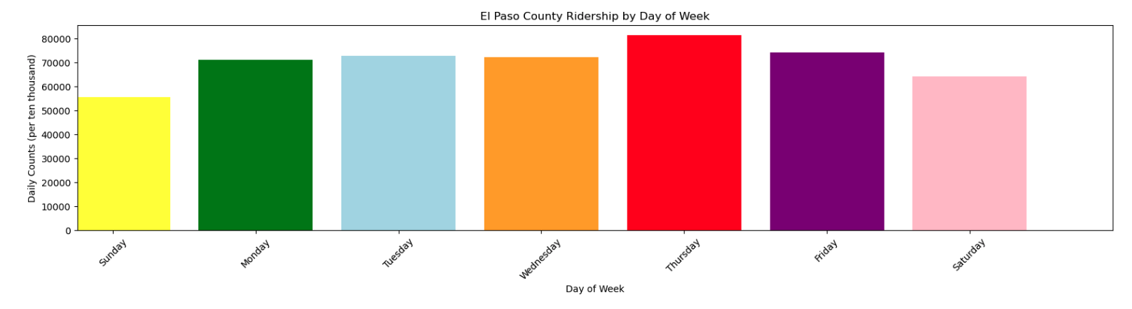
DIFFERENCES EMERGE IN DAILY RIDERSHIP
El Paso County before 2020 was the second-most populous county in the state behind Denver. In this ridership analysis, its peak rider days was Thursday, followed by other weekdays. The two weekend days showed the lowest ridership. Income was considered as a factor, but a 2014 comparison of median household income showed that El Paso’s income of $59,286 was above Denver’s $54,872 but below Garfield’s $62,529.

Slide 14
GROUP 2 PROJECT 1 SUMMATION
State-provided data was free, fairly clean, and trouble-free but data was limited to about 1/3 of counties in the state.
As data was compared at the county level, changes in ridership emerged, with a midsized metro area showing difference in daily ridership.
Data allowed for examination of ridership by location.
Further incorporation of other data, such as income levels or altitude, would have provided more nuanced data.

